Slide 1
Car Rental System
Submitted in the partial fulfilment for the award of the degree of
BACHELOR OF ENGINEERING
IN
CSE Information Security
Submitted by:
Anurag Mishra
20BCS3691
Under the Supervision of:
Er. Harmandeep Kaur
Department of AIT-CSE
DISCOVER . LEARN . EMPOWER

Slide 2


CAR RENTAL SYSTEM
NEW LEADING TECHNOLOGY BY CSE(IS) STUDENTS

Slide 3
OUTLINE
CONTENTS IN THE PRESENTATION
01
02
PROBLEM FORMULATION
INTRODUCTION
03
OBJECTIVE
04
METHODOLOGY AND RESULTS
05
CONCLUSION AND FUTURE SCOPE
06
REFERENCES

Slide 4
Problem Defination
The problem with the basic approach of renting cars was that it was quite basic and was very much dependent on pen and paper method where there it was no way in which different department in the same organization could know the real time data of cars and changing of rent rates for cars was not possible.
CAR RENTAL SYSTEM
Introduction

Slide 5
Project Overview
The project that is the Car Rental System here deals with the various problem faced by the vendors of this Car rental business and as mentioned in the Problem Definition where we took the whole pen and paper approach to a digital and well-oriented manner, where the rent rates could be fixed at once and it was easy for salespersons to keep track of the cars.
CAR RENTAL SYSTEM
Introduction

Slide 6
Hardware Specifications
1.Computer
2. 2 GB Ram (minimum)
3. Pentium 3 (or higher)
CAR RENTAL SYSTEM
Software Specification
1.Operating sys: Microsoft Windows 3.1 or later,
2.Microsoft DOS, PC DOS
3.Any C/C++ Compiler
Introduction

Slide 7
The problem with the basic approach of renting cars was that it was quite basic and was very much dependent on pen and paper method where there it was no way in which different department in the same organization could know the real time data of cars and changing of rent rates for cars was not possible real time.
Now actually what happened was that there were different sales person at different points in a city/town and there were either individual or grouped vendors, now the problem here was that the main agency here had different rates depending on the different days or festive days but communication was a big issue from the main agency to the different sales point and not just the rate but the cars to rent was also a problem.
PROBLEM FORMULATION

Slide 8

The major Problem we could formulate form the above related problems were the pen and paper approach that the Car Rental business was using in their day-to-day business.
PROBLEM FORMULATION

Slide 9

OBJECTIVE
·Simple way of invoice.
·Design from a sales point perspective:
The design of the project is based from a sales point perspective where the data here can be loaded daily and the sales person can enter the software using his/her password and generate invoices.

Slide 10

OBJECTIVE
·Simple and Easy way to add vehicles.
·Better approach of communication:
Among the Sales point and the agencies as the data can be loaded daily or on the agency basis and then the data invoice can be generated.

Slide 11
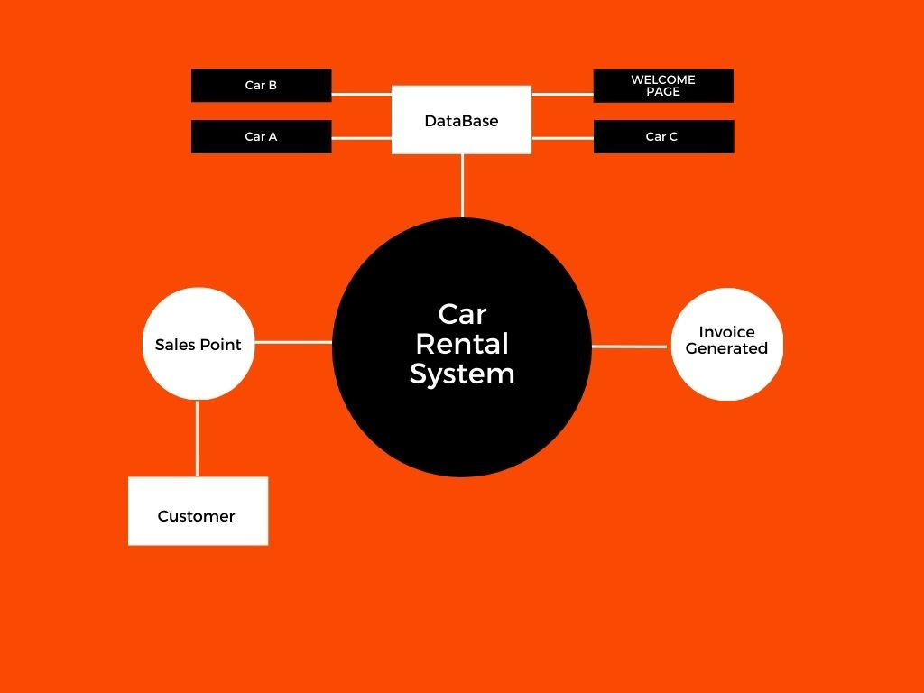
Methodology

Slide 12

Concepts Used:
1. Concept of class and object
2. Class inheritance
3. if else statements
4. File handling
5. While statements
6. Set width
7. Sleep function
8. system CLS function

Slide 13
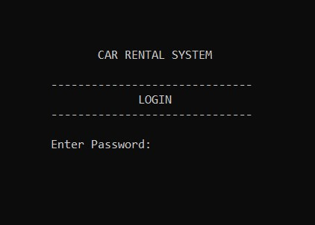
RESULT AND OUTPUT
50
40
30
20
10
0
2021
2022
2023
2024
2025

Slide 14
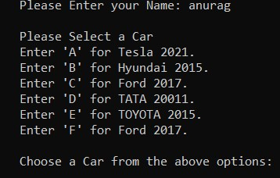
RESULT AND OUTPUT
50
40
30
20
10
0
2021
2022
2023
2024
2025

Slide 15
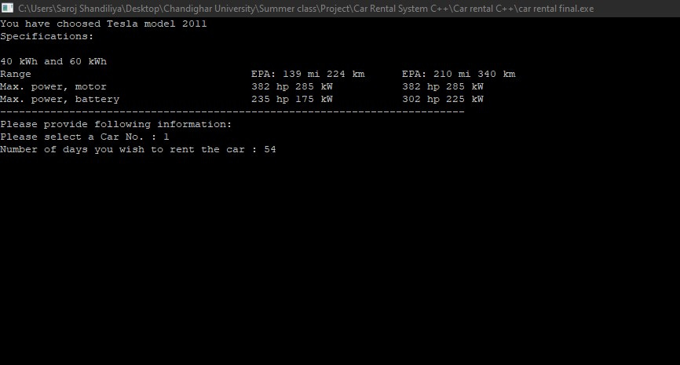
RESULT AND OUTPUT
50
40
30
20
10
0
2021
2022
2023
2024
2025

Slide 16
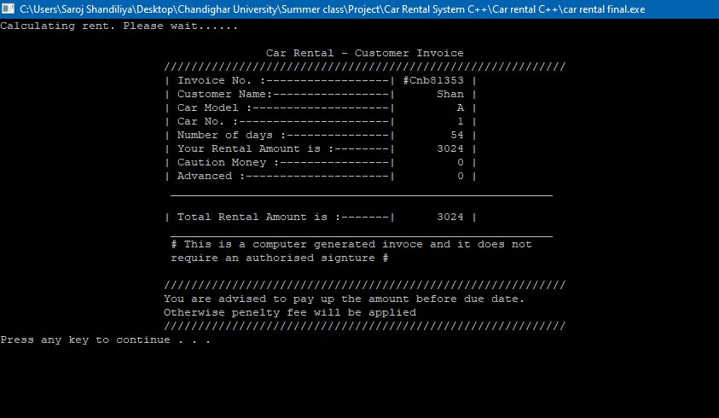
RESULT AND OUTPUT
50
40
30
20
10
0
2021
2022
2023
2024
2025

Slide 17


The project on the Car Rental System is an effective and simple solution to the various problems faced by the car rental business, but the solution can be updated with the various different requirements of different business and future requires much more study and research of the various other issues faced in the car rental business, as we had limited time so we just selected a part of the issue that was basically focused on the sales point perspective. But there are various other problems that require more of research and time.

Slide 18

FUTURE SCOPE
Website Based on the Car Rental System.
Real time Updates.
Real time Price updates .
Real time GPS tracking of cars.

Slide 19
MADE
BY -
20BCS3691
ANURAG MISHRA
2. 20BCS3689
SAROJ SHANDILIYA
3. 20BCS3677
JASWANT SINGH
UNDER THE GUIDANCE BY -
Er. HARMANDEEP KAUR

Slide 20
References
·https://www.tutorialspoint.com/cpp_standard_library/iomanip.htm
·https://www.geeksforgeeks.org/dos-h-header-in-c-with-examples/
·https://pubs.opengroup.org/onlinepubs/7908799/xsh/unistd.h.html

Slide 21
